Slide 1
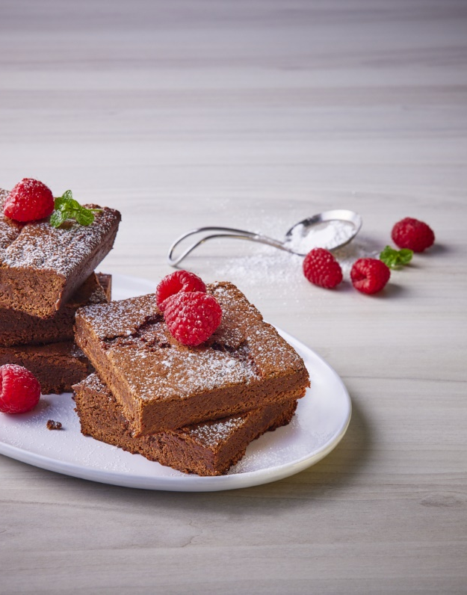
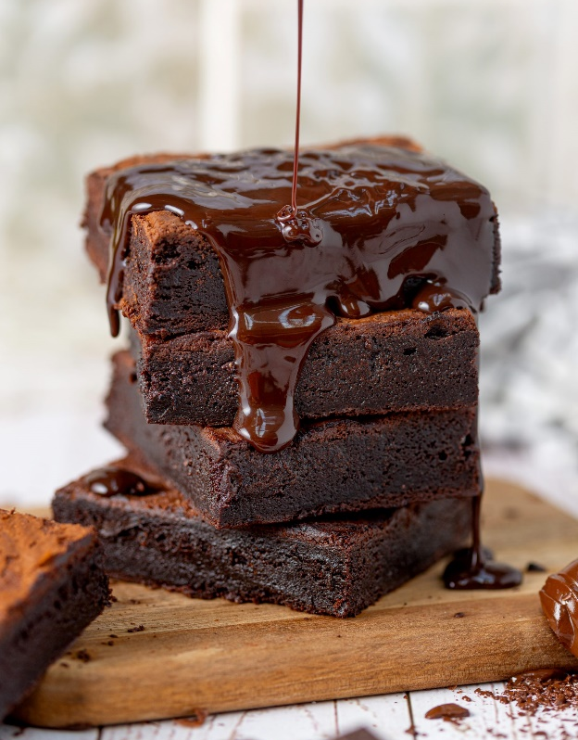
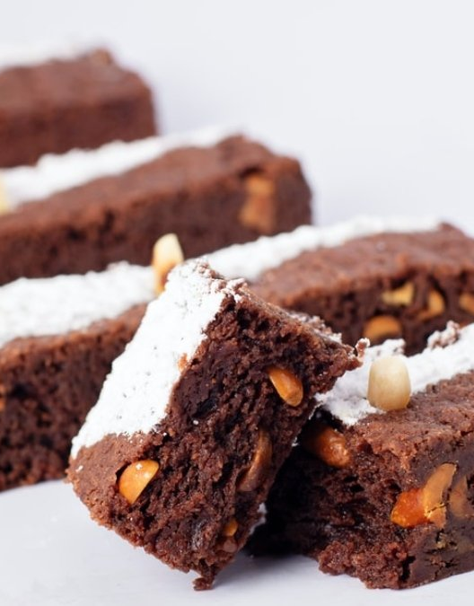
Brownies recipe
Notes:
NOTA: Para reemplazar una imagen, selecciónela y elimínela. Después, utilice el icono Insertar imagen para sustituirla por una suya.

Slide 2
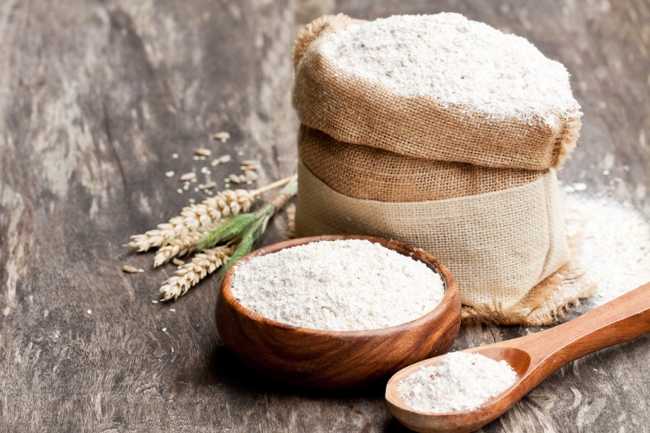
Ingredients
½ cup (70 gr) of wheat flour
½ cup (50 gr) cocoa powder
¼ teaspoon baking powder or Royal powder
1/8 teaspoon of salt

Slide 3
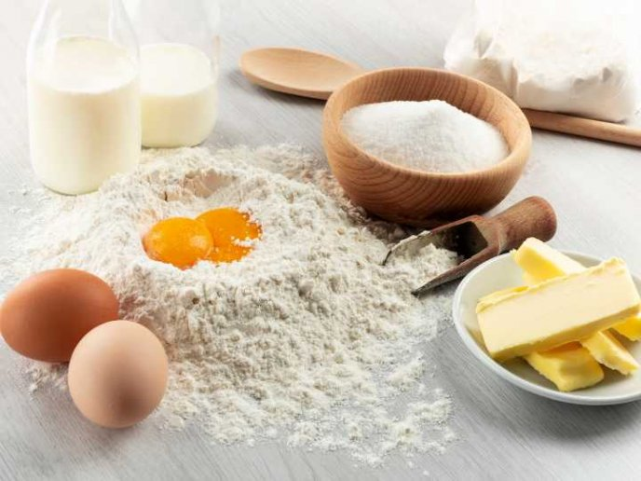
½ cup (113 gr, 8 tablespoons or 1 stick) of unsalted butter
3/4 cup (150 gr) of granulated white sugar
2 large eggs at room temperature
1 teaspoon of vanilla extract
3/4 cup (6 oz) chocolate chips (milk chocolate or dark chocolate), optional.

Slide 4
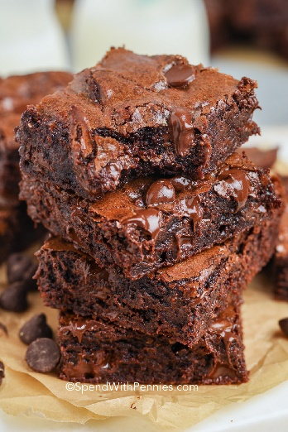
Instructions
Preheat oven to 350ºF (180ºC).
Mix flour, cocoa powder, baking powder, and salt in medium bowl. Set this mixture apart.
In a medium saucepan, melt the butter on the stove over medium low heat. Remove from the stove and let it cool down a bit.

Slide 5
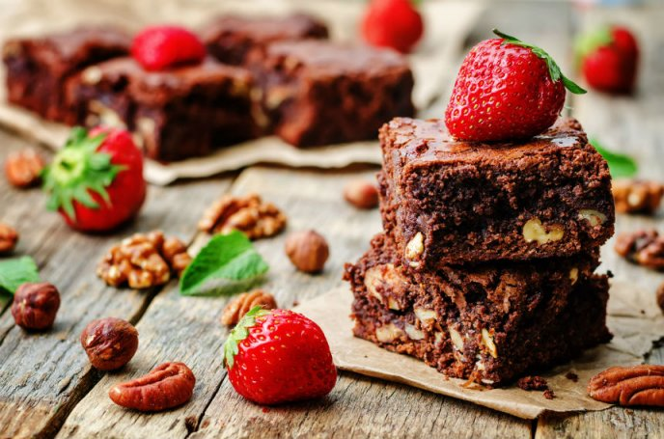
Place the melted butter in a large bowl and mix well with the white sugar. Add the eggs one at a time and beat just enough to incorporate them. Then add the vanilla extract and mix again. Now, add the flour mixture and stir to incorporate it. Make sure to scrape the sides and bottom of the bowl very well with a spatula. Finally, add the chocolate chips and stir.
Pour the mixture into an 8 x 8 inch (20 x 20 cm) greased pan and distribute it well. Bake for 25-30 minutes or until the edge of the brownies begins to peel off the pan. Don't bake them too much. Let them cool completely before serving.

Slide 6
Enjoy!

